Slide 1
Approximation Algorithm
Vertex Cover is 2 Approximation

Slide 2
Vertex cover
Vertex cover of an undirected graph is a subset of its vertices such that for every edge (u, v) of the graph, either 'u' or 'v' is in the vertex cover. Although the name is Vertex Cover, the set covers all edges of the given graph.

Slide 3
The vertex-cover problem
A vertex-cover of an undirected graph G is a subset of its vertices such that it includes at least one end of each edge.
The problem is to find minimum size of vertex-cover of the given graph.
This problem is an NP-Complete problem.

Slide 4
The vertex-cover problem …
Finding the optimal solution is hard (its NP!) but finding a near-optimal solution is easy.
There is an 2-approximation algorithm:
It returns a vertex-cover not more than twice of the size optimal solution.

Slide 5
The vertex-cover problem …
APPROX-VERTEX-COVER(G)
1 C ← Ø
2 E′ ← E[G]
3 while E′ ≠ Ø
4 do let (u, v) be an arbitrary edge of E′
5 C ← C U {u, v}
6 remove every edge in E′ incident on u or v
7 return C

Slide 6
The vertex-cover problem …
Near Optimal
size=6
Optimal
Size=3

Slide 7
Demo
Compare this cover to the one from the example

Slide 8
Polynomial Time
C ← φ
E’ ← E
while E’ ≠ φ do
let (u,v) be an arbitrary edge of E’
C ← C ∪ {u,v}
remove from E’ every edge incident to either u or v
return C
O(n²)
O(1)
O(n²)
O(n)

Slide 9
Correctness
The set of vertices our algorithm returns is clearly a vertex-cover, since we iterate until every edge is covered.

Slide 10
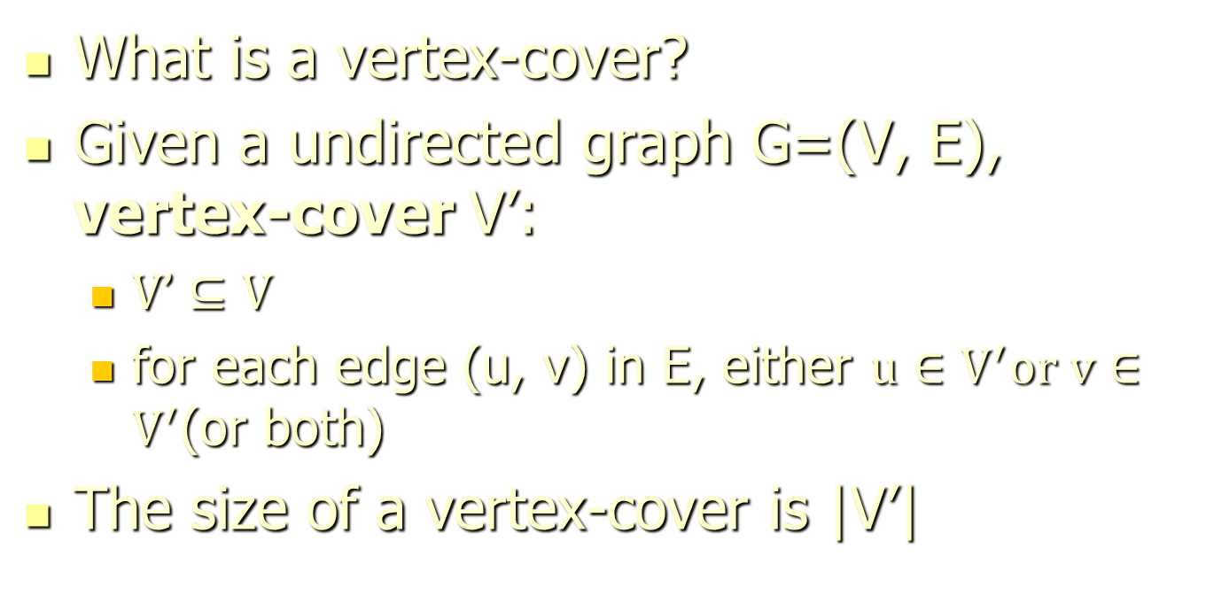
Vertex-cover problem and a 2-approximation algorithm

Slide 11
Vertex-cover problem and a 2-approximation algorithm
1b1b
c2
3d
4a
5e
6f
g7
Are the red vertices a vertex-cover?
No. why?
Edges (5, 6), (3, 6) and (3, 7) are not covered by it

Slide 12
Vertex-cover problem and a 2-approximation algorithm
1
2
3
4
5
6
7
Are the red vertices a vertex-cover?
No. why?
Edge (3, 7) is not covered by it

Slide 13
Vertex-cover problem and a 2-approximation algorithm
1
2
3
4
5
6
7
Are the red vertices a vertex-cover?
Yes
What is the size?
4

Slide 14
Vertex-cover problem and a 2-approximation algorithm
1
2
3
4
5
6
7
Are the red vertices a vertex-cover?
Yes
What is the size?
7

Slide 15
Vertex-cover problem and a 2-approximation algorithm
1
2
3
4
5
6
7
Are the red vertices a vertex-cover?
Yes
What is the size?
5

Slide 16
Vertex-cover problem and a 2-approximation algorithm
1
2
3
4
5
6
7
Are the red vertices a vertex-cover?
Yes
What is the size?
3

Slide 17
Vertex-cover problem and a 2-approximation algorithm
Vertex-cover problem
Given a undirected graph, find a vertex cover with minimum size.

Slide 18
Vertex-cover problem and a 2-approximation algorithm
1
2
3
4
5
6
7
A minimum vertex-cover

Slide 19
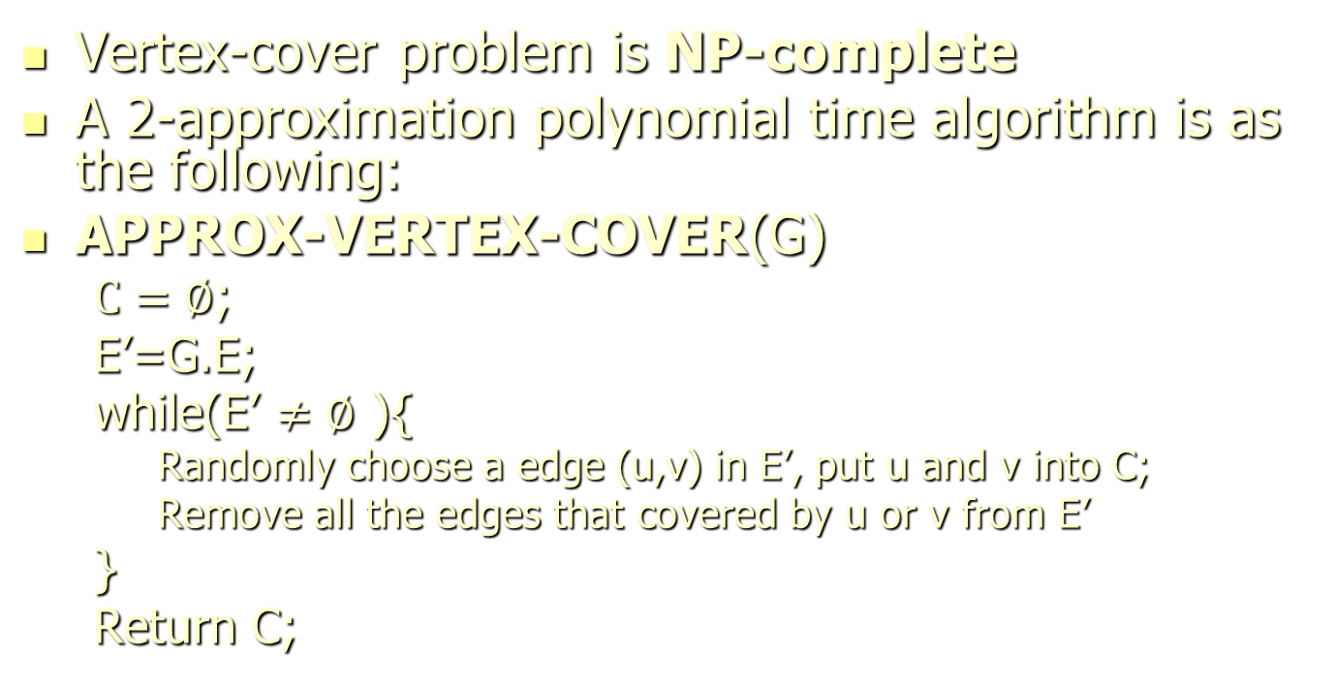
Vertex-cover problem and a 2-approximation algorithm

Slide 20
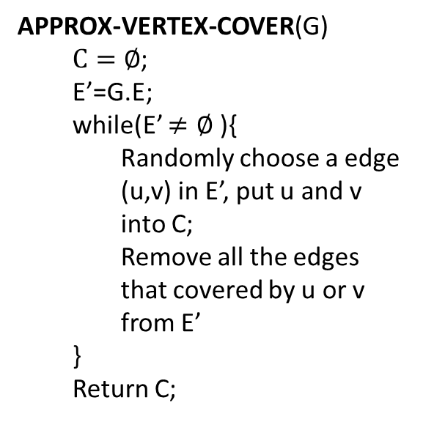
Vertex-cover problem and a 2-approximation algorithm
1
2
3
4
5
6
7

Slide 21
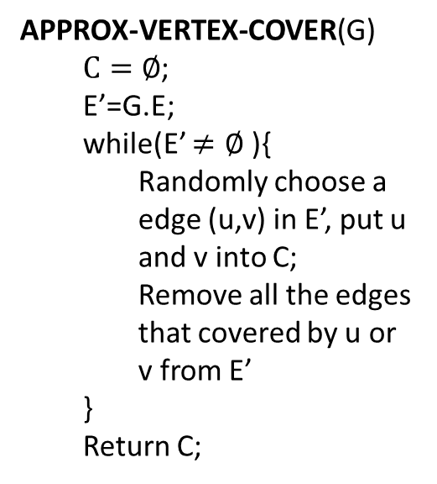
Vertex-cover problem and a 2-approximation algorithm
1
2
3
4
5
6
7
It is then a vertex cover
Size?
6
How far from optimal one?
Max(6/3, 3/6) = 2

Slide 22
Vertex-cover problem and a 2-approximation algorithm
1
2
3
4
5
6
7

Slide 23
Vertex-cover problem and a 2-approximation algorithm
1
2
3
4
5
6
7
It is then a vertex cover
Size?
4
How far from optimal one?
Max(4/3, 3/4) = 1.33

Slide 24
Vertex-cover problem and a 2-approximation algorithm
THEOREM:35.1
APPROX-VERTEX-COVER(G) is a 2-approximation algorithm
AIM:
When the size of minimum vertex-cover is s
The vertex-cover produced by APPROX-VERTEX-COVER is at most 2s

Slide 25
Proof :
APPROX-VERTEX-COVER(G) runs in Polynomial time.
Let ‘A’ denote the set of edges that were picked in line -4 of Algorithm.
In order to cover the edges in A, an optimal cover C*(U* denoted in proof) must include at least one end point of each edge in A.(By example C* includes b,e,d)
No two edges in A share an END POINTS,since once an edge is picked , all the edges incident on it are deleted from E‘.(By example –A ={ (b,c),(e,f), (d,g)} )
Thus no two edges in A are covered by the same vertex from C* and we have the lower bound.

Slide 26
NOTE:
To decide the size of the optimal cover we utilize the lower bound on the optimal cover .
By relating the size of the solution returned to the lower bound , we obtain our approximation ratio.

Slide 27
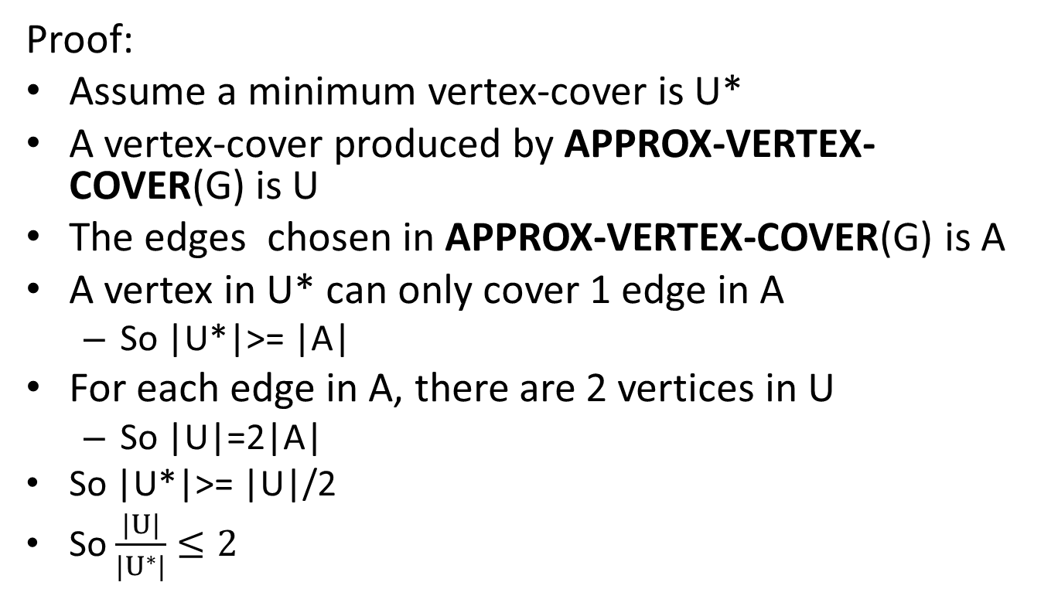
Vertex-cover problem and a 2-approximation algorithm

